Slide 1
CS 513 - KNOWLEDGE DISCOVERY & DATA MINING
Prediction of Patient Survival After one Year
Group 6:
Ruobing Liu, Wencheng Qiu, Jiayin Huang, Zimeng Zhao

Slide 2




Group Members
Ruobing Liu
CWID: 20012779
Wencheng Qiu
CWID: 20011469
Zimeng Zhao
CWID: 20012231
Jiayin Huang
CWID: 10477088

Slide 3
PROBLEM STATEMENT & OBJECTIVE
Problem Statement:
A hospital in New Jersey has been trying to improve its care conditions by looking at the historic survival of the patients. There are many factors that can affect a patient's survival, such as age, Treated_with_drugs, mental health,Residence, life style, etc.
The accurately predicting patient survival can aid in treatment decisions, personalized therapy, and the management of patient expectations. Therefore, develop accurate models for predicting patient survival can significantly impact patient care and ultimately lead to better clinical outcomes.
Objective:
Understand the predictor variables which have a larger influence on patient survival across the board.
Predict the Patient's survival after One Year of Treatment, based on different predictor variables.

Slide 4
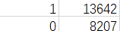
DATASET:
Dataset Variables Attributes:
ID_Patient_Care_Situation: Care situation of a patient during treatment
Diagnosed_Condition: The diagnosed condition of the patient
ID_Patient: Patient identifier number
Treatment_with_drugs: Class of drugs used during treatment
Survived_1_year: If the patient survived after one year (0 means did not survive; 1 means survived)
Patient_Age: Age of the patient
Patient_Body_Mass_Index: A calculated value based on the patient’s weight, height, etc.
Patient_Smoker: If the patient was a smoker or not
Patient_Rural_Urban: If the patient stayed in Rural or Urban part of the country
Previous_Condition: Condition of the patient before the start of the treatment. (A B C D E)
Cleaned data : remove the blanks and normalize the variables.
The dataset comprises 16 features in the form of columns (plus one tag for prediction). We use PCA and correlation for feature reduction.
Training data: 15 columns and 15,294 training rows of data.
Test data: 15 columns and 6,555 rows.

Slide 5
CLASSIFICATION TECHNIQUES USED
Methods
KNN
Naive Bayes
CART Decision Tree
Random Forest
Logistic Regression
ANN
SVM
XGBOOST

Slide 6
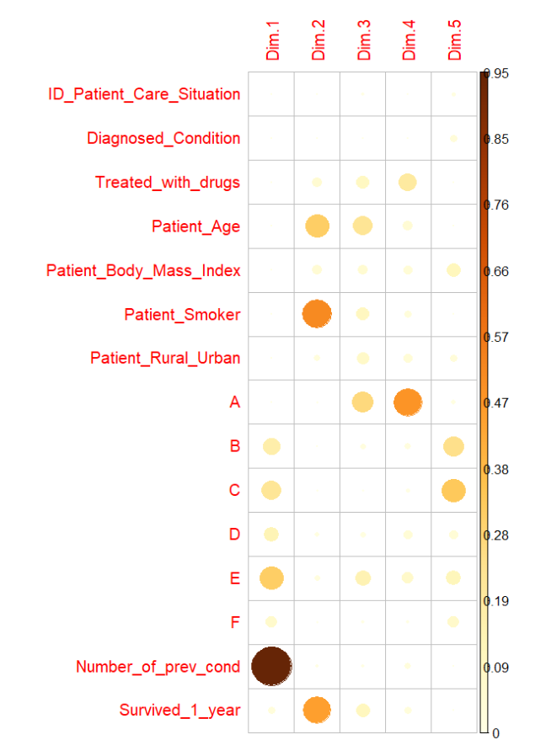
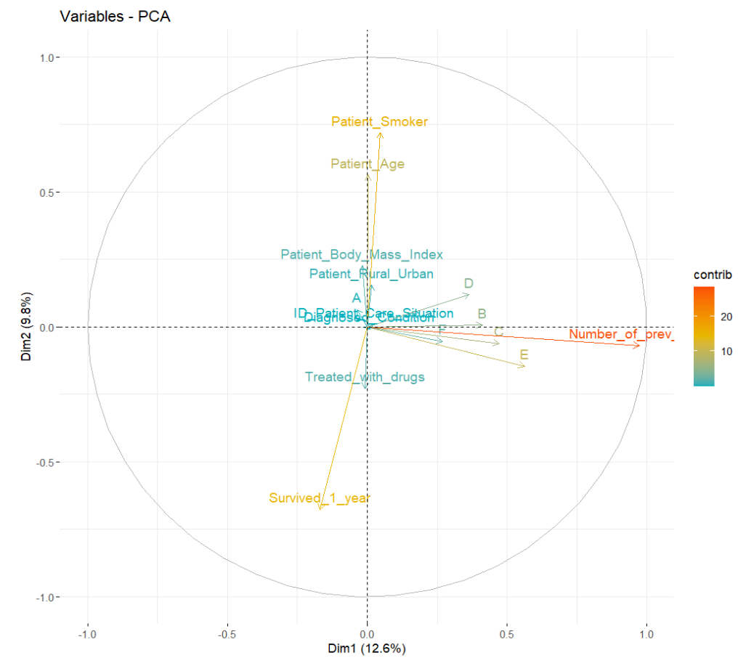
PCA

Slide 7
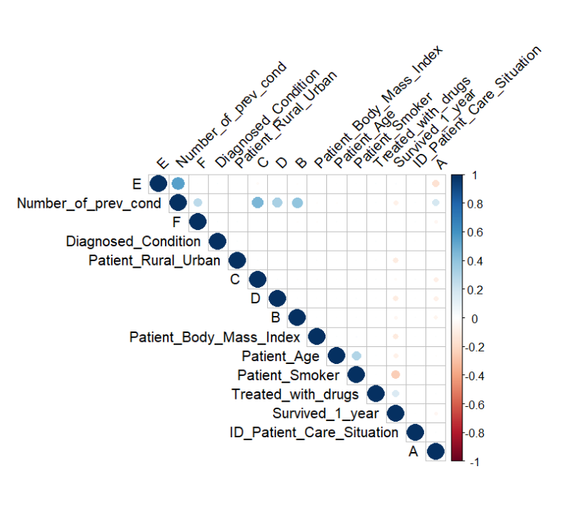
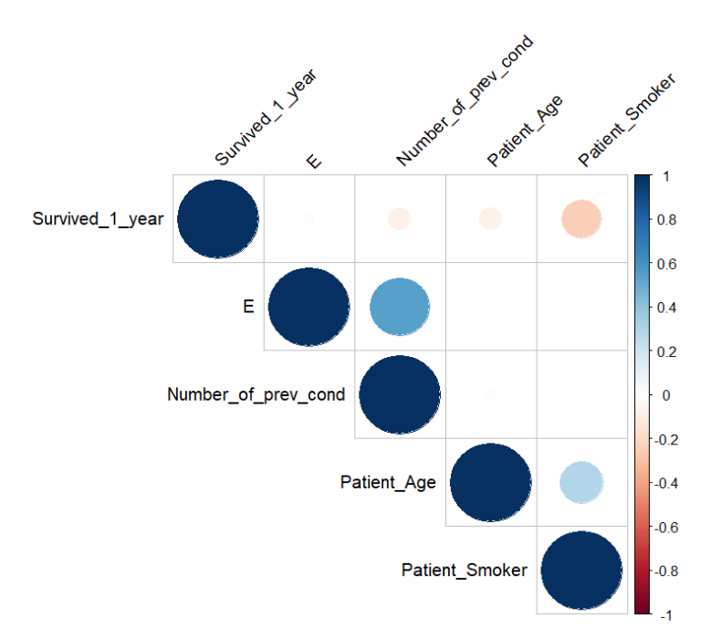
VARIABLE CORRELATION

Slide 8
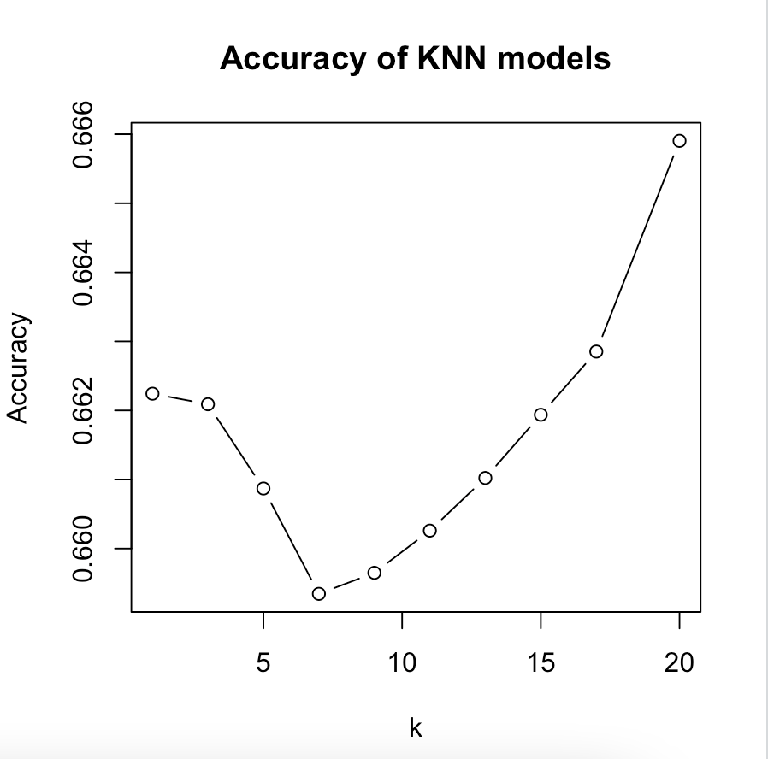
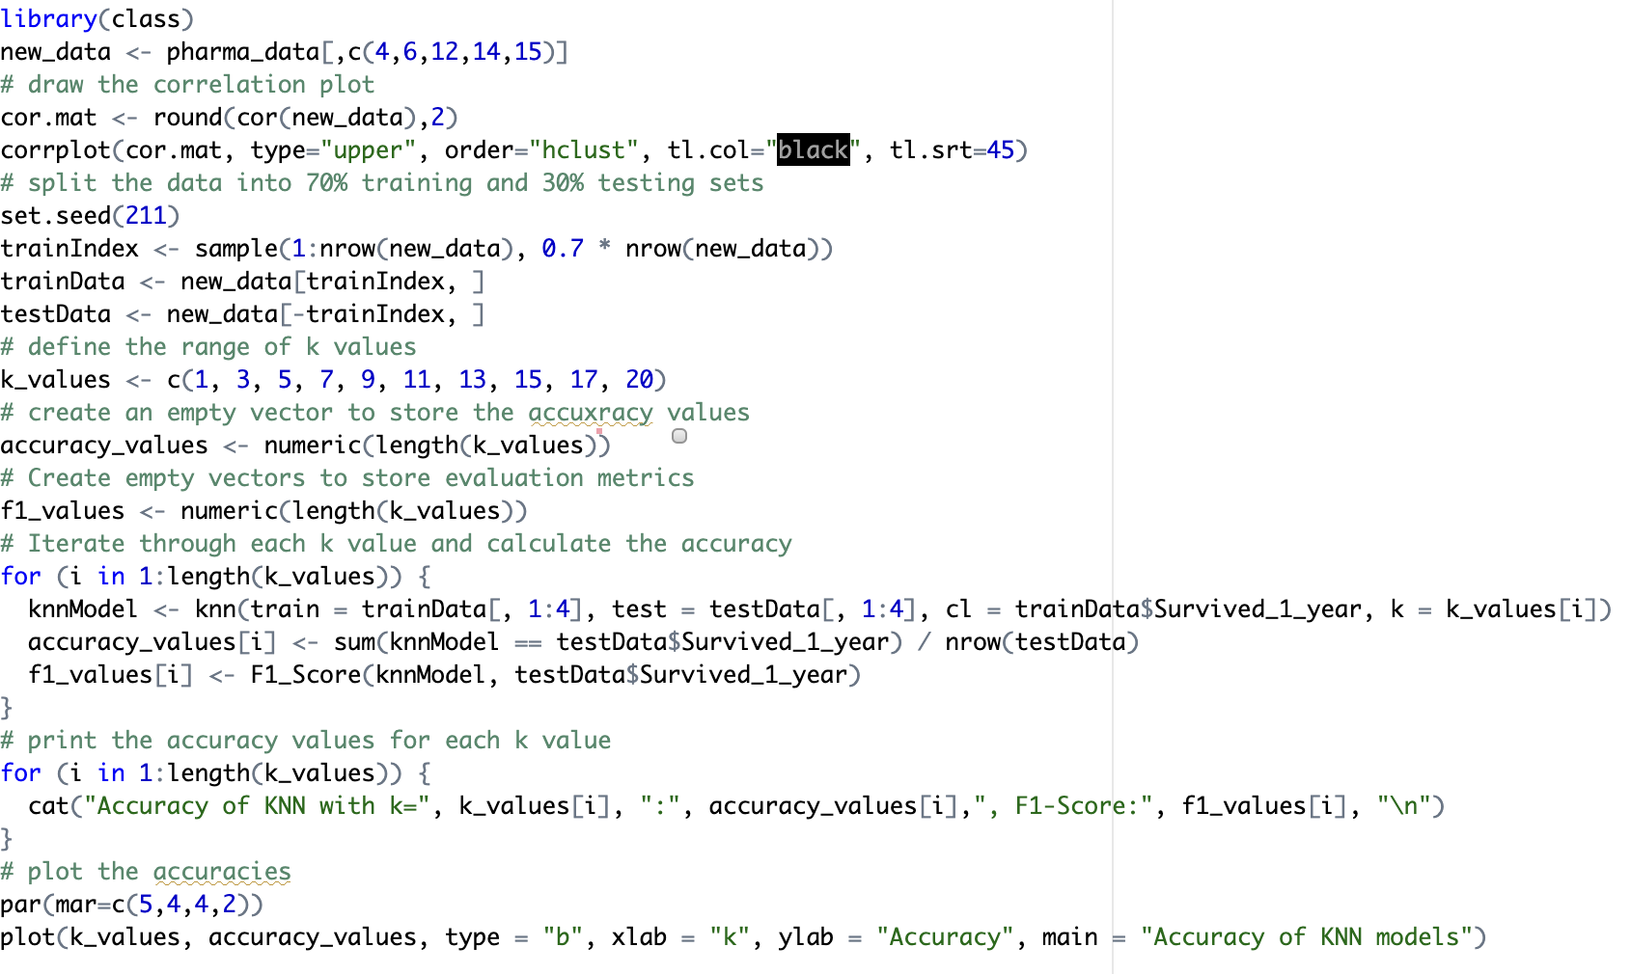
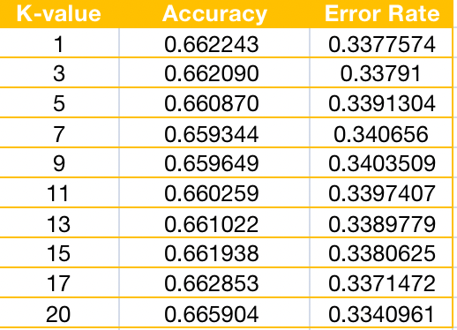
KNN METHOD
Accuracy: ~66.59%

Slide 9
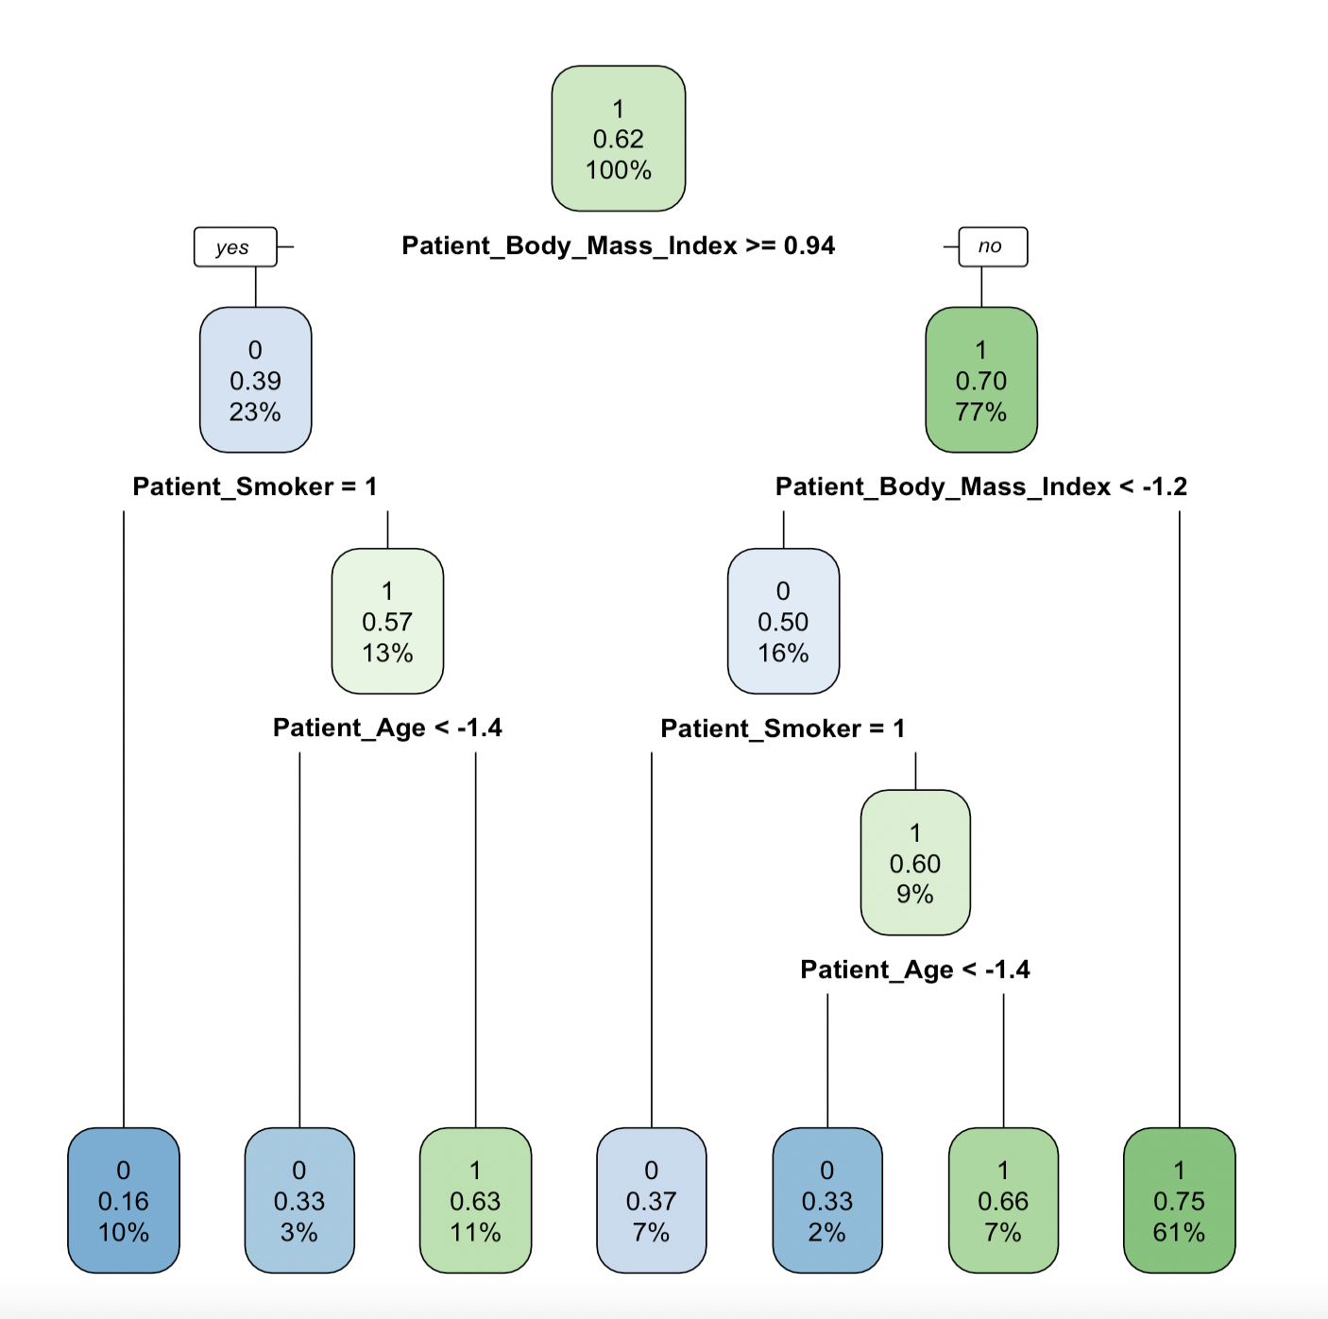
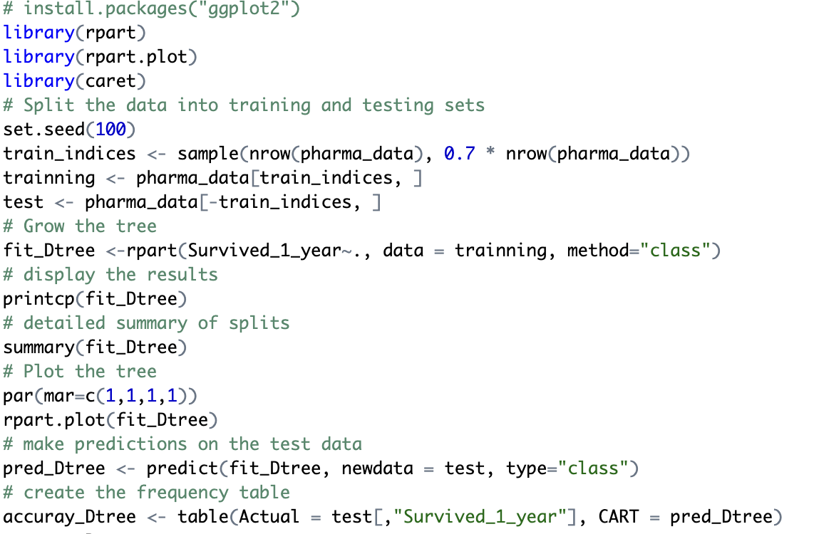
CART DECISION TREE
Accuracy: ~71.1%

Slide 10
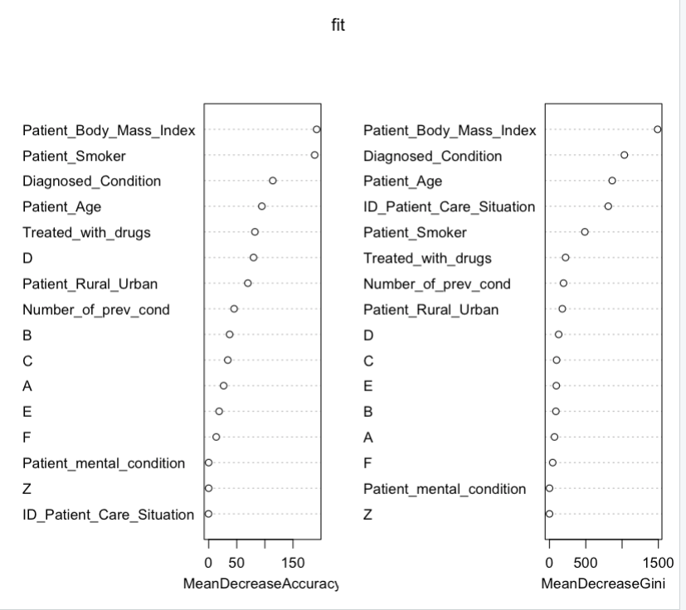
Random Forest
Accuracy: ~78.01%
- PaMent_Body_Mass_Index: This variable has a high MeanDecreaseAccuracy, indicating that it is an important predictor of survival outcome. Its MeanDecreaseGini value is also the highest among all variables, suggesting that it is a very effective at reducing impurity in the decision tree.
"Diagnosed_CondiMon" has a high MeanDecreaseAccuracy value, indicating that it is an important predictor of survival outcome. Its MeanDecreaseGini is also relatively high compared to some other variables, suggesting that it is effective at reducing impurity in the decision tree.

Slide 11
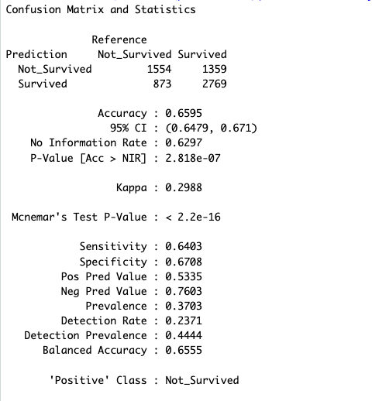
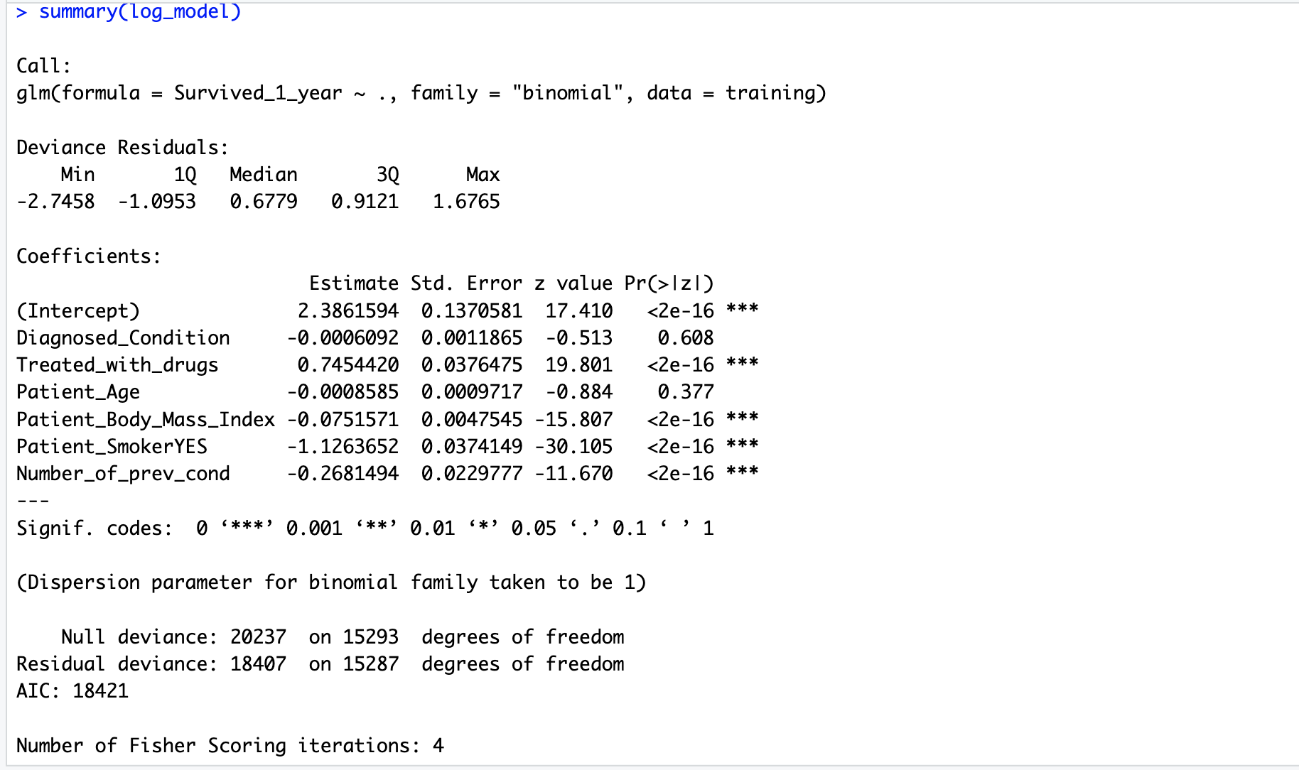
Logistic Regression
Accuracy: ~65.9%

Slide 12
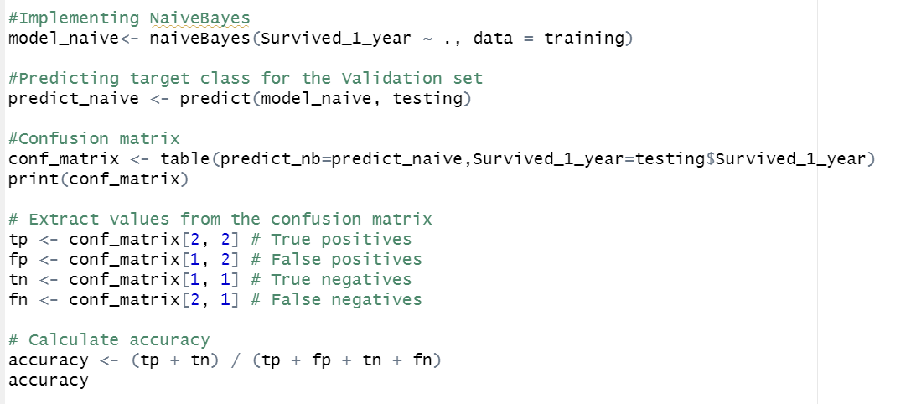
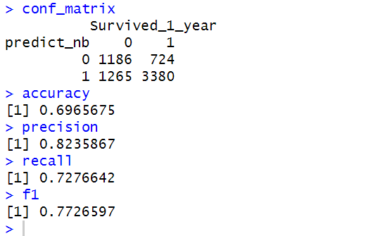
Naïve Bayes
Accuracy: ~69.66%
Independent Fast

Slide 13
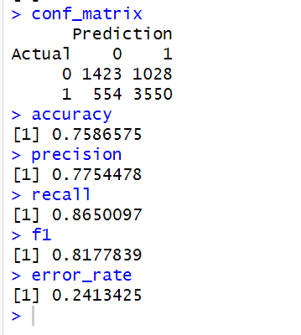
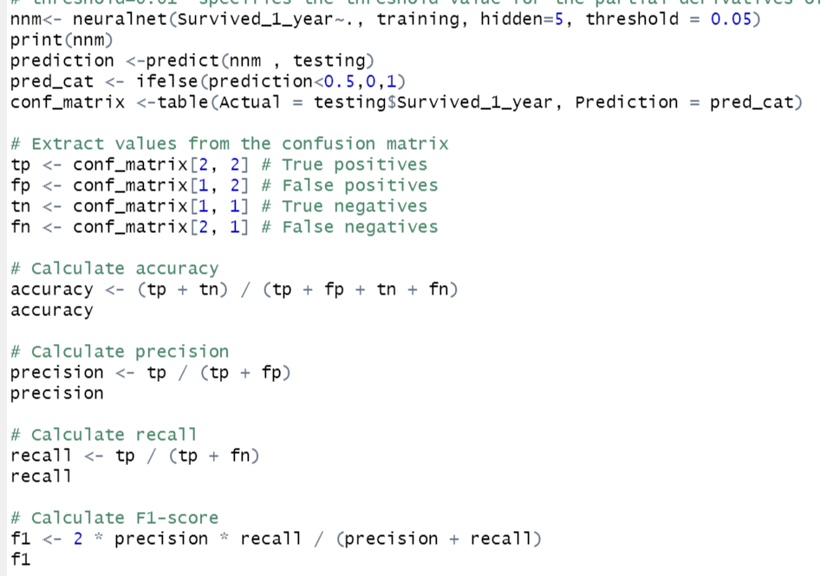
ANN
Accuracy: ~75.86%

Slide 14
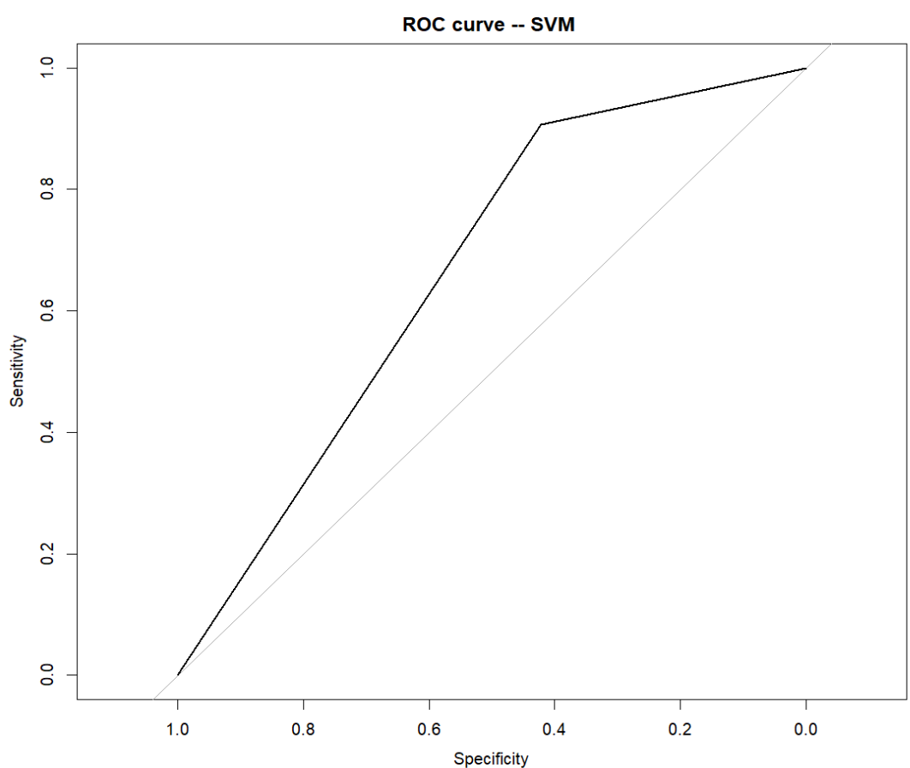
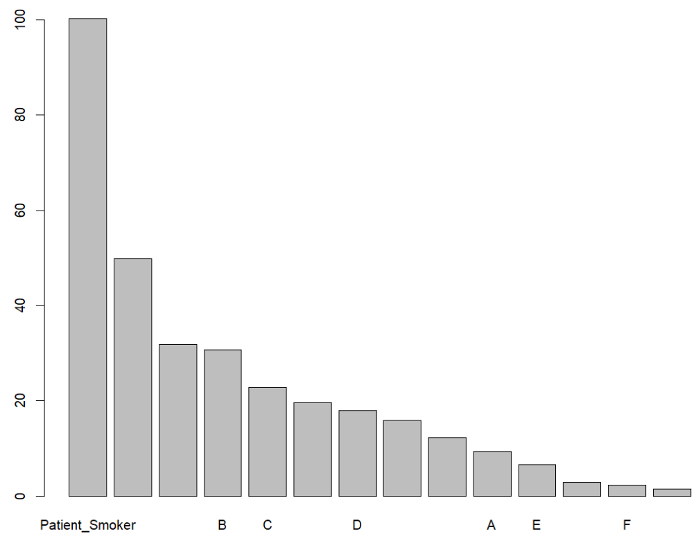
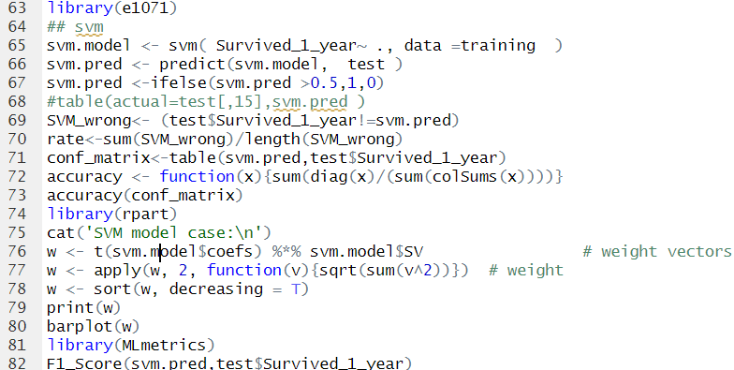
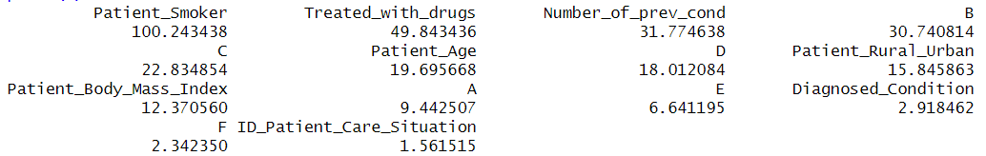
SVM

Slide 15
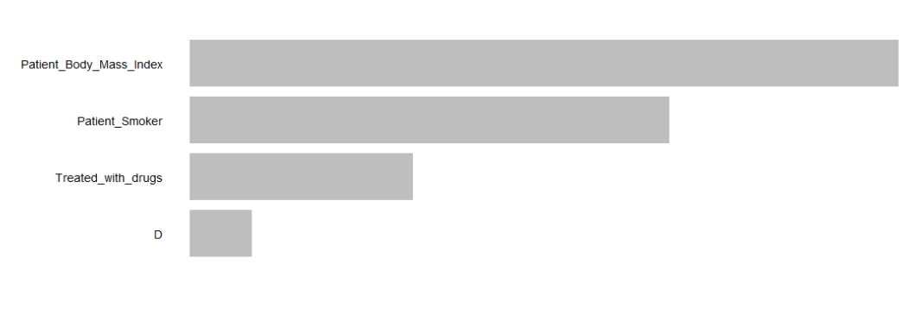
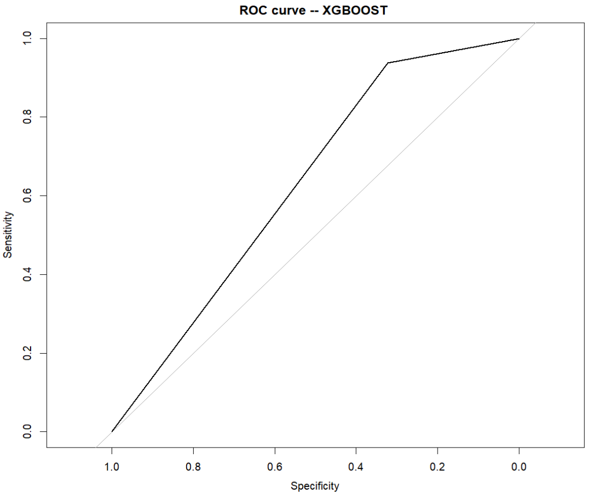
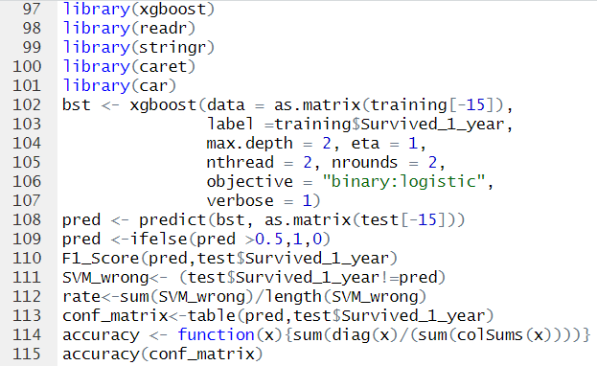
XGBOOST
New Entrants
Substitutes

Slide 16
Results and Evaluation
Model | F1 SCORE | ERROR RATE | ACCURACY
SVM | 0.5500382 | 26.96% | 73.04%
XGBOOST | 0.4560408 | 29.26% | 70.74%
KNN | 0.4475277 | 33.41% | 66.59%
CART Decision Tree | 0.5044433 | 28.92% | 71.08%
Naïve Bayes | 0.7726597 | 30.34% | 69.66%
ANN | 0.8177839 | 24.13% | 75.87%
Random Forest | 0.834577 | 21.98% | 78.01%
Logistic Regression | 0.7098613 | 34.05% | 65.95%

Slide 17
Conclusion
Patient Survived_1_year is most closely linked to prediction of patient survival after one year .
The main attributes affecting whether a patient survives after one year are:Patient_Smoker,Number_of_previous_conditions,Patient_Age and E
The Random Forest method yielded the highest accuracy for the prediction of patient survival after one year followed closely by the ANN and SVM. This may relate to their ability to resist noises.
Algorithms faster than others（Based on this database）:Logistic Regression, Naïve Bayes, CART Decision Tree, KNN and XGBoost.

